Slide 1
HTML COLORS, FAVICON, TABLES AND CSS
HAJJAT HADIJAH KYAMPEIRE

Slide 2
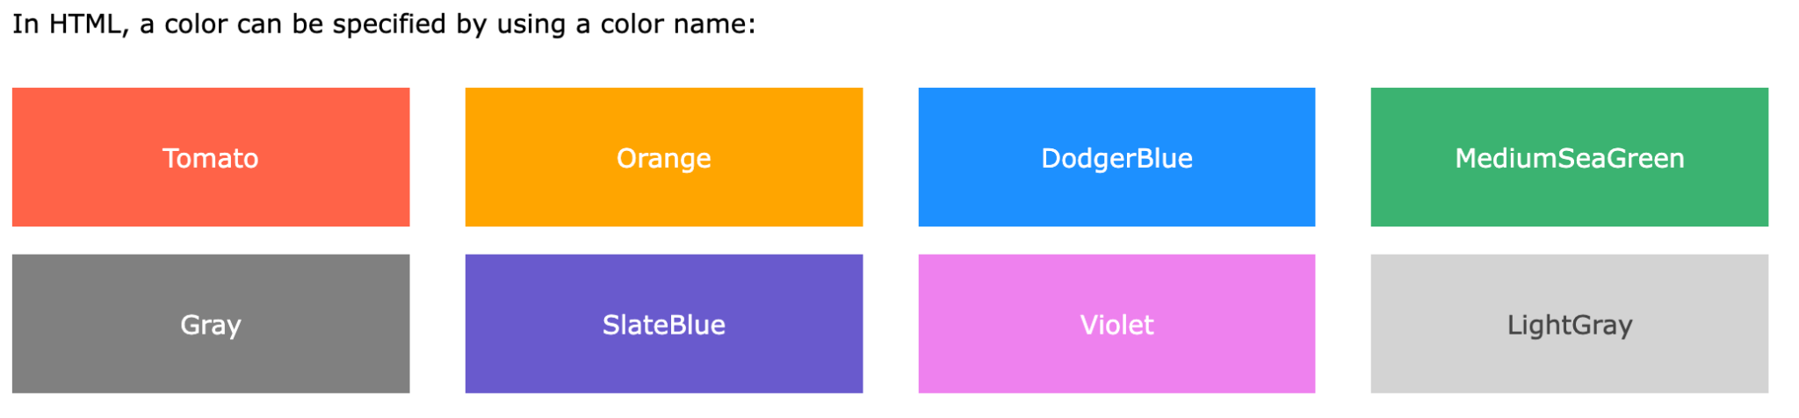
HTML colors are specified with predefined color names, or with RGB, HEX, HSL, RGBA, or HSLA values.Link to 40 standard colors.
<h1 style="background-color:Tomato;">Tomato</h1>
Background color:
<h1 style="background-color:DodgerBlue;">Hello World</h1>
Try border-color, and varying color values like;
<h1 style="background-color:rgb(255, 99, 71);">...</h1>
<h1 style="background-color:#ff6347;">...</h1>
<h1 style="background-color:hsl(9, 100%, 64%);">...</h1>

Slide 3
CSS
CSS stands for Cascading Style Sheets.CSS saves a lot of work. It can control the layout of multiple web pages all at once.
With CSS, you can control the color, font, the size of text, the spacing between elements, how elements are positioned and laid out, what background images or background colors are to be used, different displays for different devices and screen sizes, and much more!
Using CSS
CSS can be added to HTML documents in 3 ways:
Inline - by using the style attribute inside HTML elements
Internal - by using a <style> element in the <head> section
External - by using a <link> element to link to an external CSS file
Inline CSS
An inline CSS is used to apply a unique style to a single HTML element.An inline CSS uses the style attribute of an HTML element. Like the examples we have been doing. <h1 style="color:blue;">A Blue Heading</h1>

Slide 4
Internal CSS
An internal CSS is used to define a style for a single HTML page. An internal CSS is defined in the <head> section of an HTML page, within a <style> element.
The following example sets the text color of ALL the <h1> elements (on that page) to blue, and the text color of ALL the <p> elements to red. In addition, the page will be displayed with a "powderblue" background color:
<head>
<style>
body {background-color: powderblue;}
h1 {color: blue;}
p {color: red;}
</style>
</head>
<body><h1>This is a heading</h1><p>This is a paragraph.</p></body>
…

Slide 5
External CSS
An external style sheet is used to define the style for many HTML pages. To use an external style sheet, add a link to it in the <head> section of each HTML page:
…
<head><link rel="stylesheet" href="styles.css"></head>
<body><h1>This is a heading</h1><p>This is a paragraph.</p></body>...
Create a style.css file and add the following;
body {background-color: powderblue;}
h1 {color: blue;}
p {color: red;}

Slide 6
Read more about
Links: https://www.w3schools.com/html/html_links.asp
Background images: https://www.w3schools.com/html/html_images_background.asp
Table spacing and padding: https://www.w3schools.com/html/html_table_padding_spacing.asp

Slide 7
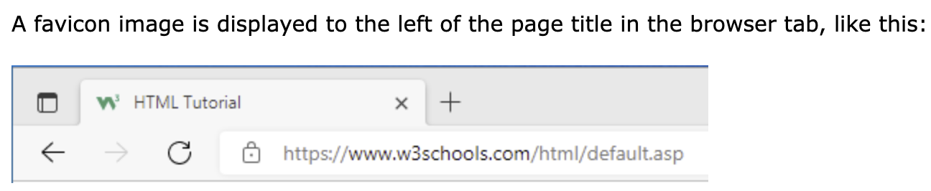
HTML Favicon
A favicon is a small image, so it should be a simple image with high contrast.
To add a favicon to your website, either save your favicon image to the root directory of your webserver, or create a folder in the root directory called images, and save your favicon image in this folder. A common name for a favicon image is "favicon.ico".
Next, add a <link> element to your "index.html" file, after the <title> element, like this:
<head> <link rel="icon" type="image/x-icon" href="/images/favicon.ico"></head>

Slide 8
HTML TABLES
HTML tables allow web developers to arrange data into rows and columns. E.G
<table>
<tr><th>Company</th><th>Contact</th><th>Country</th></tr>
<tr><td>Alfreds Futterkiste</td><td>Maria Anders</td><td>Germany</td></tr>
<tr><td>Centro comercial Moctezuma</td><td>Francisco Chang</td><td>Mexico</td></tr>
</table>
Table Cells: Each table cell is defined by a <td> and a </td> tag.
Table Rows: Each table row starts with a <tr> and ends with a </tr> tag.
Table Headers: Sometimes you want your cells to be table header cells. In those cases use the <th> tag instead of the <td> tag:

Slide 9
Table borders
To add a border, use the CSS border property on table, th, and td elements: Example in css
table, th, td {border: 1px solid black;}
Collapsed Table Borders
To avoid having double borders like in the example above, set the CSS border-collapse property to collapse.
This will make the borders collapse into a single border:
table, th, td {border: 1px solid black; border-collapse: collapse;}
With the border-radius property, the borders get rounded corners:
With the border-style property, you can set the appearance of the border with various styles e.g dotted.
th, td {
border-style: dotted;
}

Slide 10
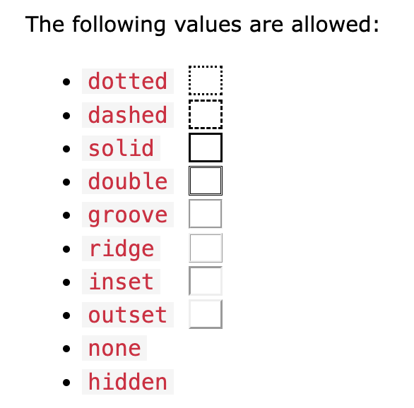
Border styles

Slide 11
Table Colspan and Rowspan
To make a cell span over multiple columns, use the colspan attribute:
<table>
<tr><th colspan="2">Name</th><th>Age</th></tr>
<tr><td>Jill</td><td>Smith</td><td>43</td></tr>
<tr><td>Eve</td><td>Jackson</td><td>57</td></tr>
</table>
To make a cell span over multiple rows, use the rowspan attribute:
<table>
<tr> <th>Name</th><td>Jill</td> </tr>
<tr><th rowspan="2">Phone</th> <td>555-1234</td></tr>
<tr><td>555-8745</td></tr>
</table>

Slide 12
Table styling
HTML Table - Zebra Stripes
If you add a background color on every other table row, you will get a nice zebra stripes effect. To style every other table row element, use the :nth-child(even) selector like this:
tr:nth-child(even) {background-color: #D6EEEE;}
HTML Table - Vertical Zebra Stripes
To make vertical zebra stripes, style every other column, instead of every other row.
td:nth-child(even), th:nth-child(even) {background-color: #D6EEEE;}
Hoverable Table
Use the :hover selector on tr to highlight table rows on mouse over:
tr:hover {background-color: #D6EEEE;}

Slide 13
HTML Table Colgroup
If you want to style the two first columns of a table, use the <colgroup> and <col> elements. The <colgroup> element should be used as a container for the column specifications.
Each group is specified with a <col> element.
The span attribute specifies how many columns that get the style.
The style attribute specifies the style to give the columns.
<table>
<colgroup>
<col span="2" style="background-color: #D6EEEE">
</colgroup>
<tr><th>MON</th><th>TUE</th><th>WED</th><th>THU</th></tr>...
You can hide columns with the visibility: collapse property: <col span="3" style="visibility: collapse">

Slide 14
Next Lecture classes, id, lists, HTML graphics, Media,

